Slide 1

BLOCKCHAIN
Basic Concepts and
Definitions
Prof. Sunitha R
Department of Computer Science Engineering

Slide 2

BLOCKCHAIN
Blockchain Key Concepts
Prof. Sunitha R
Department of Computer Science Engineering

Slide 3
BLOCKCHAIN
Learning Content
Learn about the History, categories, Protocol stack, usage and differences between tokens and cryptocurrency.

Slide 4
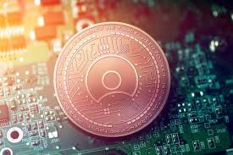
BLOCKCHAIN
Token Definition
It rise to lots of decentralized Applications and Decentralized Autonomous Organization(DAO)
It is a digital asset
An underlying distributed ledger
Programmable assets or access rights
Managed by a smart contract
Notes:
A token is a digital asset. It is an object of value itself, or representation of any other asset on a digital ledger. A token can be native which serves as an incentive to help protect the network from attack and has governance rule-set, example is Bitcoin which is being paid to miners for block creation and validation. Ether; which is used for payment of transactions to the nodes carrying out block validation and confirmation. This is a perfect example of a token economy as it is reward based on the systematic reinforcement of target behavior.

Slide 5
BLOCKCHAIN
History
Shells and beads were probably the earliest types of tokens used.
For example: casinos chips, vouchers, cards, bonus points in a loyalty program, coat check tokens, stock certificates, bonds.
Recyclable bottles are a good analogue example for a token
A garbage bag could also represent a recycling token if it is issued with a recycling value.
Notes:
Recyclable bottles are a good analogue example for a token. In some countries, bottles you buy in supermarkets are issued as tokens, as they have a recycling value of usually a few cents printed on them. This is money that you pay on top of the initial price of the product, and has become a method for governments to encourage the recycling of materials and subsequent reduction of litter in public places. If you return the bottle to the supermarket or other collecting entities, you will get reimbursed with the recycling value stated upon the token you return – the bottle. Losing the bottle is equivalent to losing money.
A garbage bag could also represent a recycling token if it is issued with a recycling value. In some parts of Switzerland, for example, you can’t just throw out trash in a bin in a random bag. You have to pay for the bag up front, which includes a dumpster fee, and you can only use those bags to dispose of your trash. As opposed to most other countries, where you pay your garbage bill monthly, as part of your utility bill tied to the rent of your apartment or house, this system requires you to purchase these special plastic bags. These tokenized plastic bags come at a higher cost than regular supermarket plastic bags, and are issued and managed by local authorities.

Slide 6
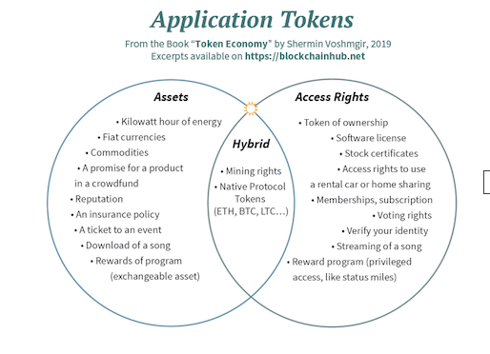
BLOCKCHAIN
Cryptographic Token
Cryptographic tokens represent a set of rules, encoded in a smart contract – the token contract.
Notes:
Cryptographic tokens represent a set of rules, encoded in a smart contract – the token contract. Every token belongs to a blockchain address. These tokens are accessible with a dedicated wallet so ware that communicates with the blockchain and manages the public-private key pair related to the blockchain address. Only the person who has the private key for that address can access the respective tokens. This person can, therefore, be regarded as the owner or custodian of that token. If the token represents an asset, the owner can initiate transfer of the tokens by signing with their private key, which in turn generates a digital fingerprint or digital signature. If the token represents an access right to something somebody else owns, the owner of that token can initiate access by signing with their private key, thereby creating a digital fingerprint. If the token represents a voting, the owner of that token can vote by signing with their private key, creating a digital signature

Slide 7
BLOCKCHAIN
Token categories
Work or Utility Based tokens
Asset-based tokens
Security Based tokens
Notes:
Application Stack Tokens could be classified as work/utility, security or asset-backed token.
A work or utility token can be used as access right to contribute to a network like a DAO and receive reward for carrying out a particular task. This kind of token can also be exchanged for a service or product. A scarce utility token on a high-demand useful service/market can create massive value for holders of such token.
Security token gives holders right of equity in your venture. Holders can lay claim to revenue or profit of the venture. Issuers of such tokens promise returns to holders. Any token that passes the Howey Test is considered an investment contract or simply a Security token and this has been a long standing battle with Regulators still trying to find the right legislation for the industry.
Asset-backed tokens are backed with tangible assets like bonds, stocks, properties, gold, car, etc. The tokens represent the physical assets and transferring from one person to another confers the new holder as the owner of such asset.

Slide 8
BLOCKCHAIN
Tokens
ERC-20
It is on Ethereum network
This tokens were used for crowdfuncing
ERC 721
Main use of this is digital collectibles
First implemented in cryptokitties
ERC 1411
Security token

Slide 9
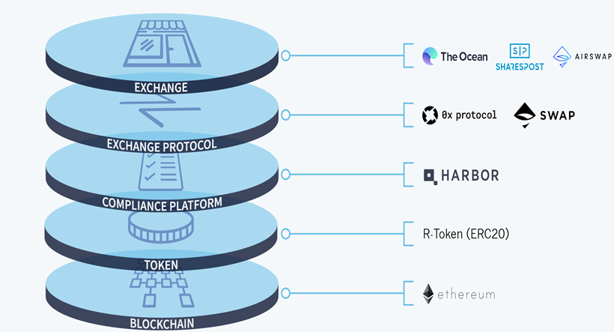
BLOCKCHAIN
Security token Protocol Stack
Notes:
The blockchain is the foundation offering trustless transactions, fast settlement times, security and the network on which all higher levels in the stack are built. The blockchain offers issuers and regulators visibility and provides investors with connectivity and discoverability leading to liquidity.
The security token is the on-chain technology layer that, in combination with the compliance platform, enforces compliant transactions required by issuers and regulators.
The compliance platform consists of off-chain processes that conduct issuer due diligence,ensure that investors are qualified to participate in offerings and later trades, and update rules and permissions dynamically over time to ensure compliant secondary trading.
Exchange protocols like 0x and Swap are an essential layer to ensure a global liquidity pool. Exchange protocols connect order books from different marketplaces and enable the exchange of tokenized securities by providing developers an open protocol to build on. The decentralized protocols lower the cost of trading, remove barriers for overseas investors, and enhance security as it is not a centralized third party that holds funds or securities.
Exchanges (exchanges, 0x relayers, second-layer protocols) provide a venue for liquidity, where buyers and sellers find trade execution once secondary trades are allowed to occur. In the Security Token Stack, it is essential that marketplaces have met the regulatory guidelines required for operating as an exchange.

Slide 10
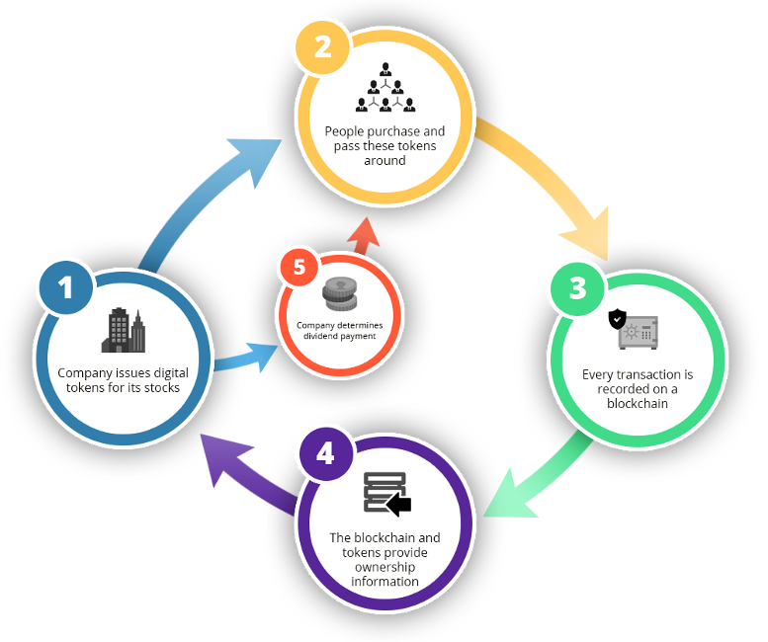
BLOCKCHAIN
Security token Blockchain
Notes:
The blockchain is the foundation offering trustless transactions, fast settlement times, security and the network on which all higher levels in the stack are built. The blockchain offers issuers and regulators visibility and provides investors with connectivity and discoverability leading to liquidity.
The security token is the on-chain technology layer that, in combination with the compliance platform, enforces compliant transactions required by issuers and regulators.
The compliance platform consists of off-chain processes that conduct issuer due diligence,ensure that investors are qualified to participate in offerings and later trades, and update rules and permissions dynamically over time to ensure compliant secondary trading.
Exchange protocols like 0x and Swap are an essential layer to ensure a global liquidity pool. Exchange protocols connect order books from different marketplaces and enable the exchange of tokenized securities by providing developers an open protocol to build on. The decentralized protocols lower the cost of trading, remove barriers for overseas investors, and enhance security as it is not a centralized third party that holds funds or securities.
Exchanges (exchanges, 0x relayers, second-layer protocols) provide a venue for liquidity, where buyers and sellers find trade execution once secondary trades are allowed to occur. In the Security Token Stack, it is essential that marketplaces have met the regulatory guidelines required for operating as an exchange.

Slide 11
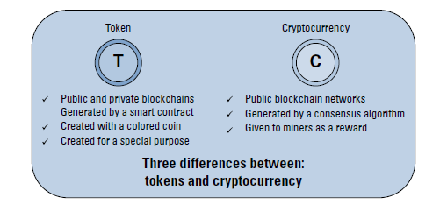
BLOCKCHAIN
Token v/s Coin
Main difference between cryptocurrency and tokens is mainly who creates them.

Slide 12
BLOCKCHAIN
Supplementary readings
https://bitcoin.org/en/
https://www.blockchain.com/

Slide 13
THANK YOU
Sunitha R
Department of Computer Science Engineering
sunithar@pes.edu
+91 80 6666 3333 Extn 721

